Slide 1
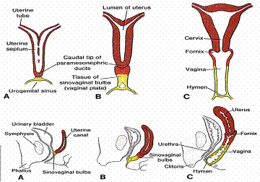
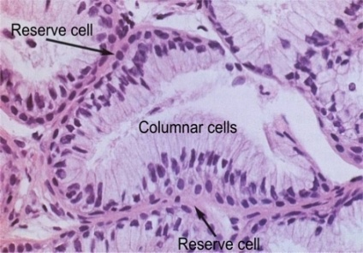
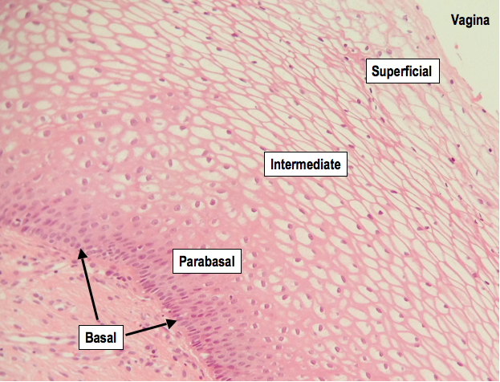
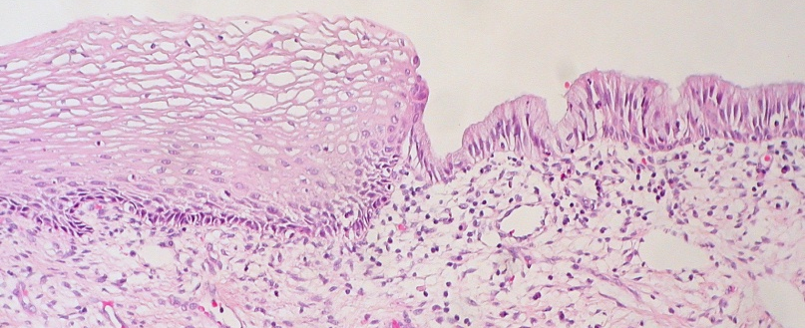
Fig(1)
(http://www.layyous.com/en/gynaecology/mullerian-ducts-anomalies-uterine-abnormalities)
Fig (3)
Fig (2)
(http://www.eurocytology.eu/static/eurocytology/eng/cervical/LP1ContentAcontC.html)
Fig (4)
Layers of squamous epithelium (http://micro2tele.com/2013/01/20/histoquarterly-cervix/)
Normal squamocolumner junction (http://commons.wikimedia.org/wiki/File:Cervix_Uteri_Normal_Squamocolumnar_Junction)

Slide 2
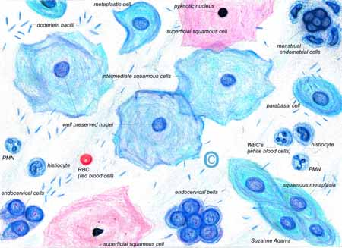
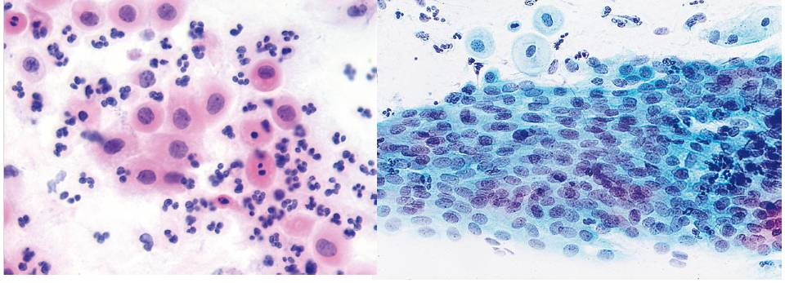
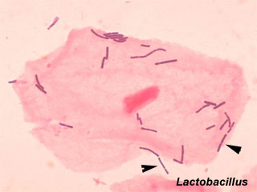
Fig (8)
Normal cervical cells (http://www.i2k.com/~suzanne/normalpap.htm)
Fig (9)
A
B
A: Parabasal-type cells and leukocytes in a cervical smear taken after menopause (Vooijs et al.; 2008). B: Atrophic epithelium is composed almost exclusively of parabasal cells, often arranged in broad, flowing sheets (Cibas, 2009).
Fig (10)
Gram-positive Lactobacillus rods among squamous epithelial cells in vaginal smear (https://embryology.med.unsw.edu.au/embryology/index.php/Histology_Stains)

